Slide 1
Bdd climate control project update
Connected Vehicle Analytics – GDIA
Aman Chopra
Mahtab Fard
06/23/2020

Slide 2
Key Points From Last Meeting
After meeting last Monday (06/15), we discussed how sub-zero temperatures in the core compressor of a vehicle’s climate system can cause blockages due to ice formation. This poses a concern, as the A/C system will fail to produce cold air, if any air at all.
We also studied several graphs portraying the gap between the compressor’s internal temperature and the temperature requested by the passenger. The logarithmic patterns of the compressor temperature suggest that driving behavior (start/stop, acceleration/deceleration, braking, speed) creates this gap and may play a factor in these temperature drops.
We ultimately decided that F-150s with variable displacement compressors would be most ideal to study, as they transmit high frequency & volume data in BDD.
* All temperatures being analyzed are in °C.

Slide 3
Objectives
We developed the following objectives with hopes to further analyze this climate system challenge.
Perform rudimentary analysis on Explorer.
Identify selection criteria for F-150s.
Determine CAN signals of interest.
Collect data for F-150s.
Conduct analysis.
Scale study to other vehicle types.

Slide 4
Explorer Analysis: VIN #############0811
Our study is divided into two main analyses:
Analyzing the time intervals during which the actual temp. is below 0°C.
What is the duration that the internal temp. of the compressor is below 0°C?
How often is the internal temp. below 0°C?
Understanding how the difference in actual temp. and requested temp. changes through the span of data collection.

Slide 5
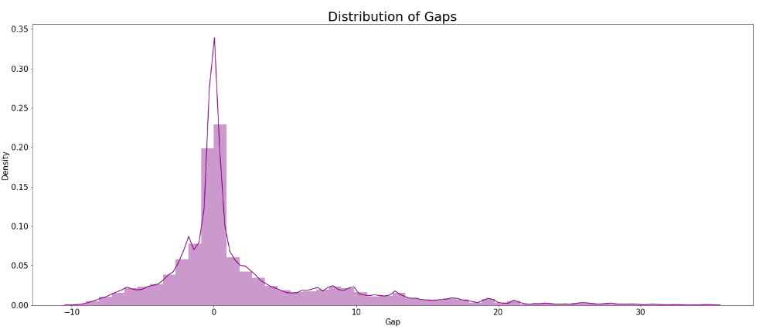
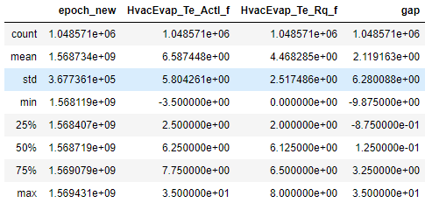
Understanding the Difference in Actual and Requested Temperature
The span of data collection for this VIN (Explorer 2019) was ~15 days (09/10/2019 – 09/25/2019). The descriptive statistics are highlighted below. All temperatures are presented in °C.

Slide 6
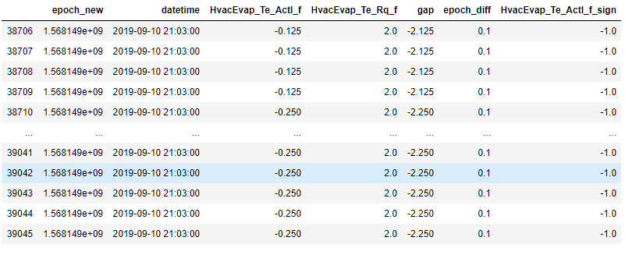
Analyzing Time Intervals With Negative Temperatures
We began by defining a trip by a continuous time interval, such that the difference between epoch is less than 1800 seconds (30 minutes). Given that data was only collected for 15 days, we made the assumption that each trip was less than 60 minutes. There were 75 trips total based on this definition.
Next, we identified all intervals where the actual compressor temp was consistently negative. We found 703 such intervals, with the interval below being the largest lasting for 33.9 seconds. We ensured that all intervals were within trips, rather than containing multiple trips.

Slide 7
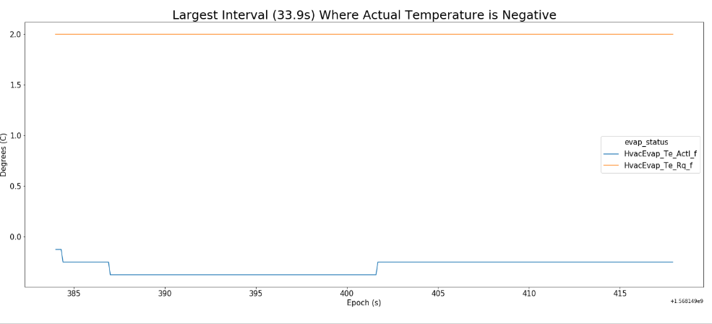
Analyzing Time Intervals With Negative Temperatures

Slide 8
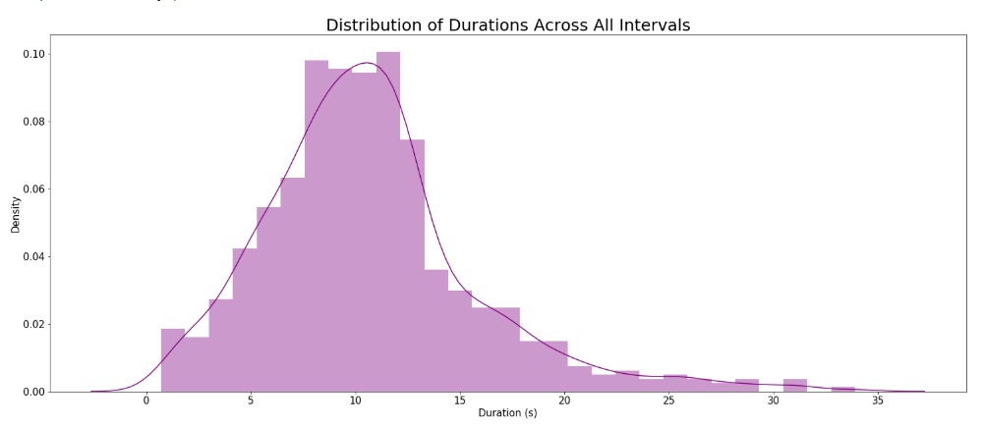
Analyzing Time Intervals With Negative Temperatures
We then sought to answer the first sub-question (What is the duration that the internal temp. of the compressor is below 0°C?) by analyzing the distribution of durations across all intervals with negative compressor temperatures.

Slide 9
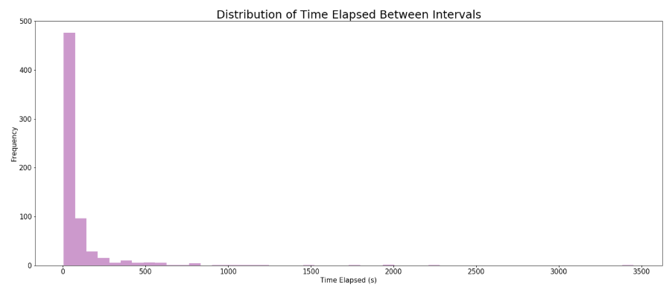
Analyzing Time Intervals With Negative Temperatures
Lastly, we gained insight into the second sub-question (How often is the internal temp. below 0°C?) by analyzing the distribution of time elapsed between intervals.

Slide 10
Findings
It appears that the gap in actual temperature (°C) and requested temperature (°C) is mostly centered around 0 with a standard deviation of 6.28. Roughly 30% of gaps lie within 1 std. of 0.
On average, intervals with continuous negative compressor temperatures last for 10.6 seconds, with some lasting as long as 33 seconds and some as low as 0.7 seconds. We plan to analyze driving behavior to further understand these intervals of longer durations.
The compressor temperature reaches negative temperatures quite frequently, every 105 seconds on average.

Slide 11
F-150 Selection Criteria
Ensure at least 30 days worth of recorded data transfers.
Preferable to select fewer vehicles with more frequent transfers, rather than more vehicles with less transfers and a shorter timestamp range.
Focus on 2018 & 2019 F-150.
Subset vehicles with transfer timestamps during summer months (May - August).
Select vehicles with variable displacement compressors.
64 2018 F-150s
784 F-150 VINs from BDD
100 2019 F-150s

Slide 12
What’s Next?
This preliminary study was completed for 1 Explorer VIN. Our plan is to replicate this with the F150s we have selected, while also including analyzing other signals, like start/stop, acceleration/deceleration, speed/velocity, braking, and other driving behavior.
Our next step is to determine CAN signals of interest, and then proceed with the remainder of the flowchart below.
Perform rudimentary analysis on Explorer.
Identify selection criteria for F-150s.
Determine CAN signals of interest.
Collect data for F-150s.
Conduct analysis.
Scale study to other vehicle types.

Slide 13
Appendix

Slide 14
Notebooks w/ Analysis: https://github.ford.com/MFARD/BDD-Climate-Control

Slide 15
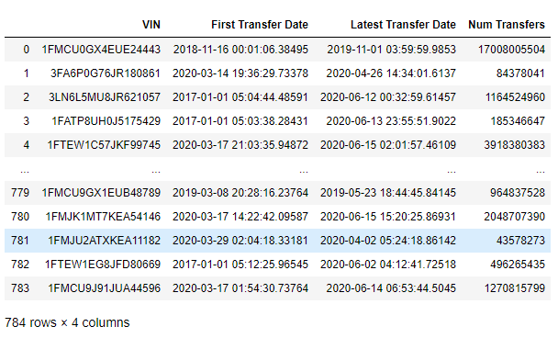
F-150 Selection
Extract all 784 F-150 VINs from BDD.

Slide 16
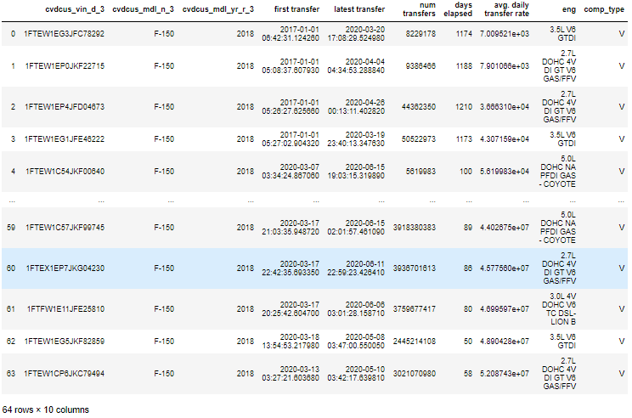
F-150 Selection
64 2018 F-150s subset based on selection criteria.

Slide 17
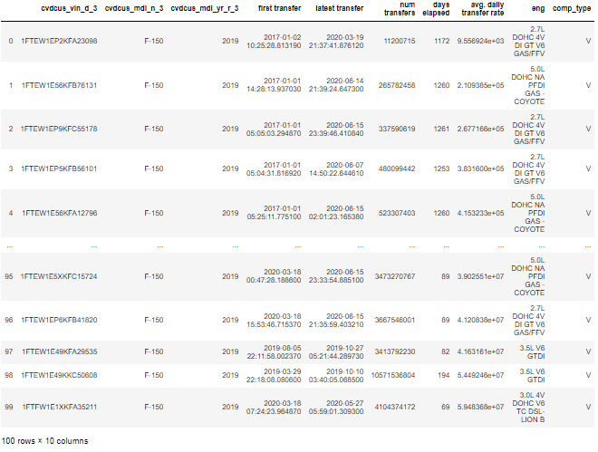
F-150 Selection
100 2019 F-150s subset based on selection criteria.

